Slide 1
Bayesian statistic- Theory and Application
Hua Lin
Based on Shuang Zhang’s lecture
Xishuangbanna Tropical Botanical Garden, CAS
2021-9-11

Slide 2
The aims of statistics
Relationship: Y(dependent variable)~X (Independent variable)
Impact: X on Y

Slide 3
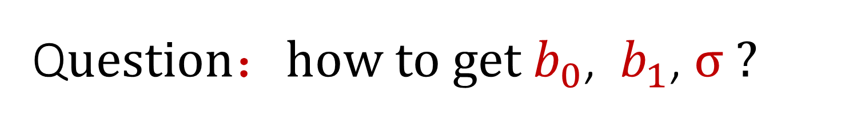

Statistic model： a tool to quantify the relationship between Y and X
Linear regression model：
Y =${ b}_{0}$ +${ b}_{1}$x + error, error ~N(0,$σ^{2}$)
${ b}_{0}$, ${ b}_{1}$, $σ$为模型中的参数
Q$uestion{：how to get b}_{0}$, ${ b}_{1}$, $σ ?$

Slide 4
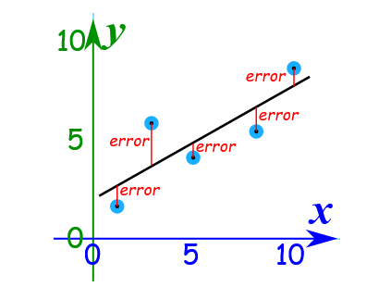

${To get b}_{0}$, ${ b}_{1}$, $σ$
Two camps：
Frequentists VS. Bayesians
point estimate- calculation
（ Ordinary least squares最小二乘法，
maximum likelihood estimation最大似然法,
restricted estimation maximum likelihood限制性最大似然法）
Least square
https://www.mathsisfun.com/data/least-squares-regression.html

Slide 5
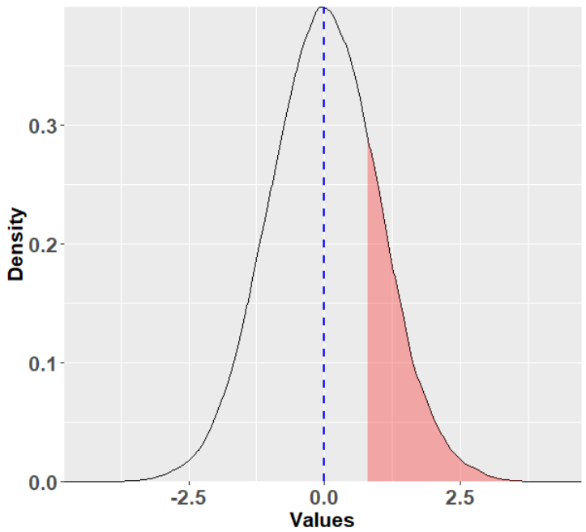
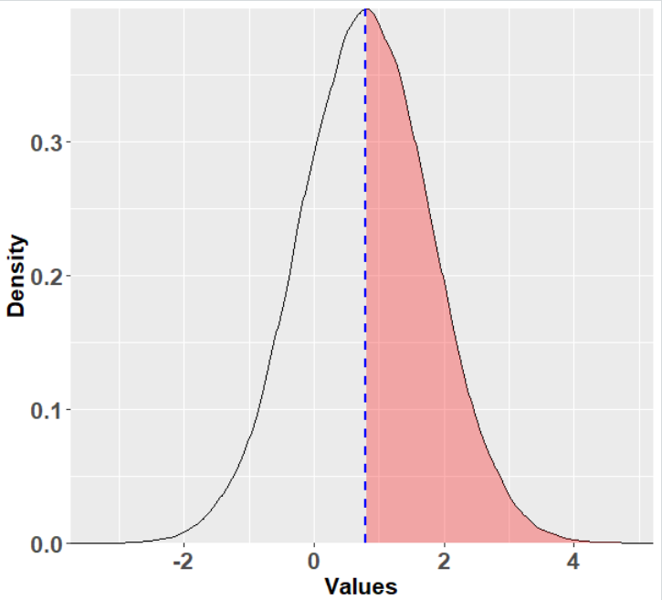

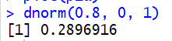
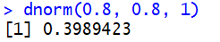
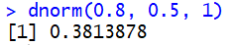
maximum likelihood estimation
Likelihood: The probability to get the observed data.
Maximum likelihood estimation:
Example: We have a number 0.8, from SD=1,
what is the probability of distribution of the dataset?
Mean=0, SD=1
Mean=0.8, SD=1
Mean=0.5, SD=1

Slide 6
one data —— several data
We measured six samples, dataset A：0.8， 0.6， 0.9， 0.3，0.7， 0.4
mean: 0.616667, sd:0.2316607
The probability density to get A from a normal distribution with mean=0.6, sd=1
The probability density to get A from a normal distribution with mean=0.8, sd=0.3
Which distribution is more fit to the measured data?
Normal (0.6, 1), Normal (0.8, 0.3), Normal(0.616667,0.2316607)?

Slide 7
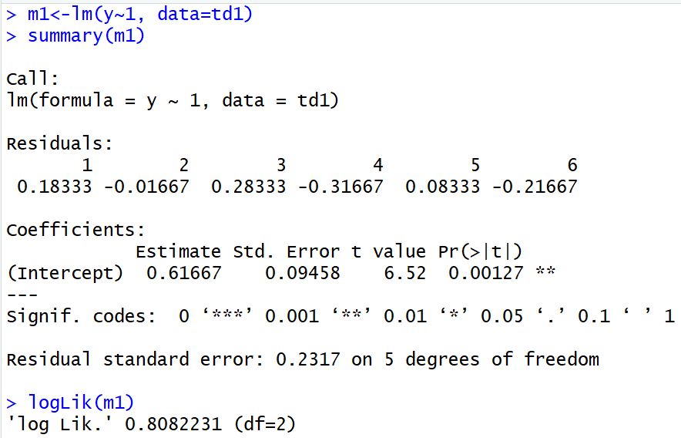
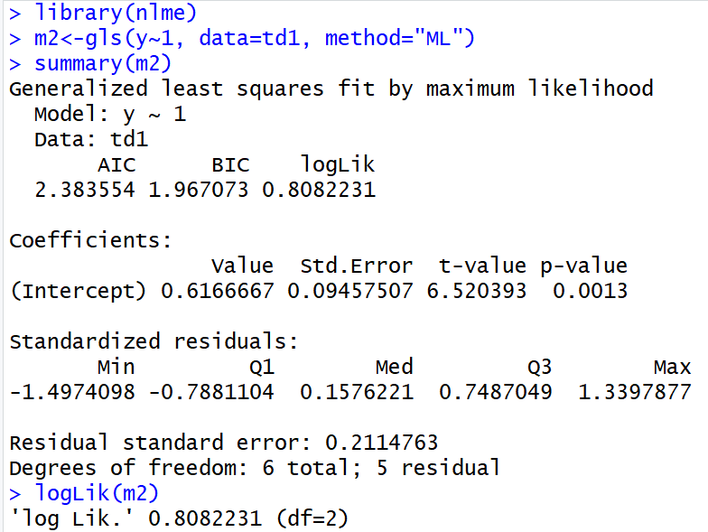
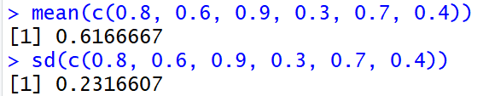
Least square v.s. Maximum likelihood

Slide 8
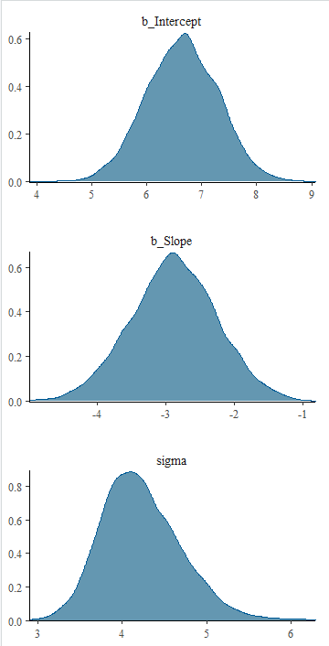
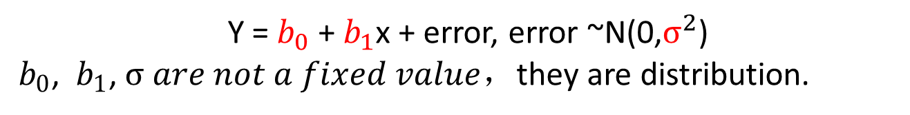
Bayesian Statistic
we make probability statements about model parameters （prior distribution），different distribution produce different probability to get the observed data
Adjust the prior distribution according to the probability, then get the posterior distribution.
Y =${ b}_{0}$ +${ b}_{1}$x + error, error ~N(0,$σ^{2}$)
${ b}_{0}$, ${ b}_{1}$, $σ are not a fixed value$，they are distribution.

Slide 9
Bayesian statistics gives the distribution of the model parameters

Slide 10
Summary: Frequentist v.s. Bayesian statistics
Frequentist ：The observed data are randomly sampled from a fixed distribution （the parameters of the distribution is fixed，point estimation）
Bayesian： The observed data are from the distribution with different parameters . You have different probability to get your data under different parameters of the distribution. （paramters are not fixed，distribution estimation）。

Slide 11

Bayes Theorem formula：
P(A|B) = P(A∩B)/P(B)
P(A|B) : conditional probability, the probability of condition when event A is occurring while event B has already occurred. 事件B发生的前提下，A也发生的概率
P(B): the probability of event B
P(A ∩ B): the probability of event A and event B
Thomas Bayes，1701-1761

Slide 12





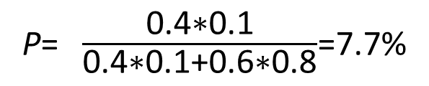
4
Male
6
Male
P(A|B) = P(A∩B)/P(B)
A: boy; B: long hair
0.1
0.8
P(A∩B) = 0.4*0.1
P(B) = 0.4*0.1+0.6*0.8
P= $\frac{\text{0.4∗0.1}}{\text{0.4∗0.1+0.6∗0.8}}$=7.7%
Probability of a boy?

Slide 13
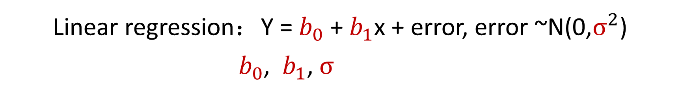
How to do Bayesian statistics ?
Linear regression：Y =${ b}_{0}$ +${ b}_{1}$x + error, error ~N(0,$σ^{2}$)
${ b}_{0}$, ${ b}_{1}$, $σ$
Guess (prior distribution)
Calculate (posterior distribution)
Adjust prior distribution according to the observed data

Slide 14

An example of Bayesian statistics
已知，在一个暗箱里，一共有四个球，这四个球，分为两种颜色：白球/蓝球 从箱子里进行了三次抽样（放回式），抽到了两蓝球，一个白球。问暗箱里蓝球和白球的比率P是多少？
1
2
3
Observed data
Distribution
Blue: white P?

Slide 15
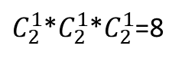
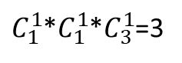
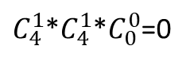
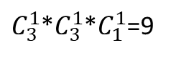
An example of Bayesian statistics
The possible data under different p (priori distribution)
1）p=0, 产生观测数据的可能组合有 0 个
2）p=0.25, 产生观测数据的可能组合
1,1,2; 1,1,3; 1,1,4; 共3种
$C_{1}^{1}$*$C_{1}^{1}$*$C_{3}^{1}$=3
3）p=0.5, 产生观测数据的可能组合
1,1,3; 1,1,4; 2,1,3; 2,1,4; 1,2,3; 1,2,4; 2,2,3; 2,2,4
观测数据
$C_{2}^{1}$*$C_{2}^{1}$*$C_{2}^{1}$=8
3）p=0.75, 产生观测数据的可能组合
$C_{3}^{1}$*$C_{3}^{1}$*$C_{1}^{1}$=9
4）p=1, 产生观测数据的可能组合
$C_{4}^{1}$*$C_{4}^{1}$*$C_{0}^{0}$=0

Slide 16
The first step: Guess
Prior distribution
1
1
1
1
1
2
2
2
2
2
3
3
3
3
3
4
4
4
4
4

Slide 17
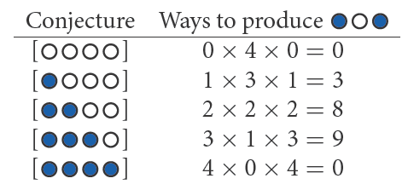
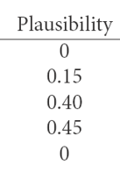
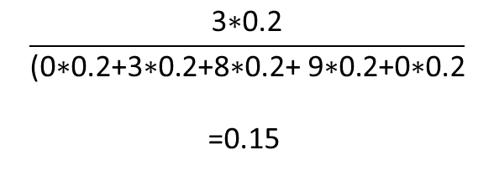
An example of Bayesian statistics
Prior distribution，
All the possibilities
(参数值的可能范围与分布)
Posterior distribution
（修正后的参数分布）
Observed data
$$\frac{\text{3∗0.2}}{\text{(0∗0.2+3∗0.2+8∗0.2+ 9∗0.2+0∗0.2}}$$
=0.15
P=0
0.2
P=0.25
0.2
P=0.5
0.2
P=0.75
0.2
P=1
0.2
Likelihood function:
the probability density of the data,
viewed as a function of the parameters—
Bayes —— Everything is distribution
Richard McElreath, 2016 Statistical rethinking, A Bayesian Course with Examples in R and Stan

Slide 18
Basic principle of Bayesian statistics
Prior distribution of parameters
＋
Observed data and likelihood function
Posterior distribution

Slide 19
The difference between Frequentists and Bayesians
Frequentists ：model parameters are fixed（point estimation）， calculation according to the observed data，using statistic（e.g. t, z test ）to test the difference with 0（P-value）
Bayesians： model parameters are not fixed ，calculate the probability density to get the observed data under different parameters. The parameters with higher probability density have higher probability in posterior distribution (no p-value). Credible interval of the parameter cross zero is significant。

Slide 20
The method to estimate parameters in Bayesian statistics
Markov Chain Monte–Carlo (MCMC) sampling

Slide 21
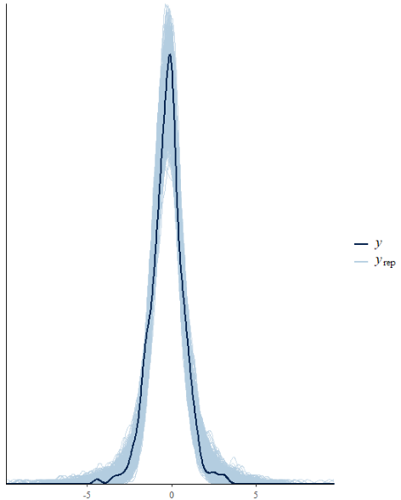
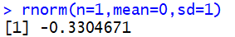
What is Monte–Carlo sampling
Monte–Carlo sampling：
Random sampling from a given probability distribution

Slide 22
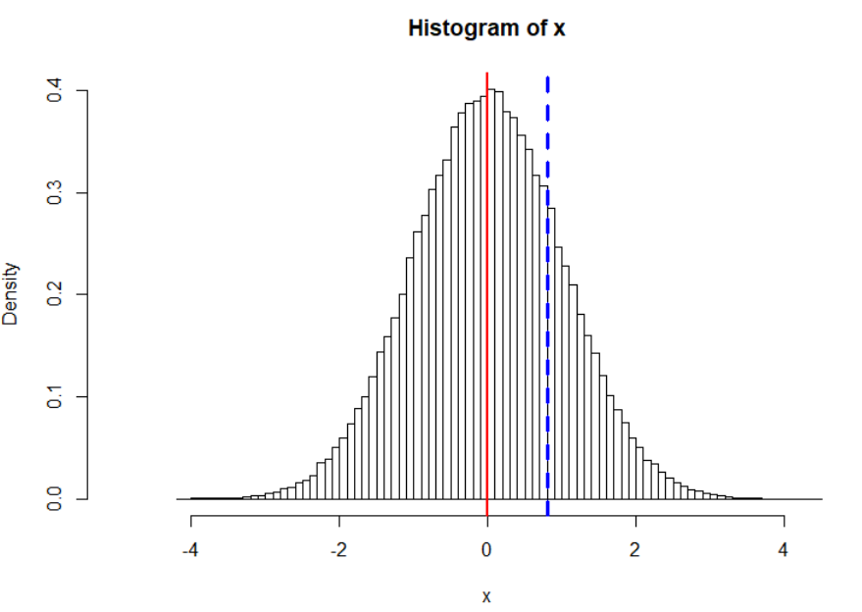
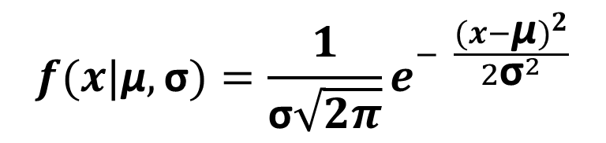
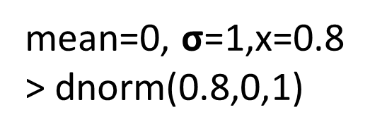
The probability density to sample a given data under a given distribution
Normal distribution (Mean = μ, sd = σ)
The probability density to sample x：
x=0.8
$$f(x|\text{μ},\text{σ})=\frac{1}{\text{σ}\sqrt{2π}}e^{− \frac{{(x−\text{μ})}^{2}}{{2\text{σ}}^{2}}}$$
mean=0, $\text{σ}$=1,x=0.8
> dnorm(0.8,0,1)

Slide 23
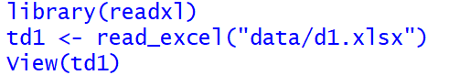
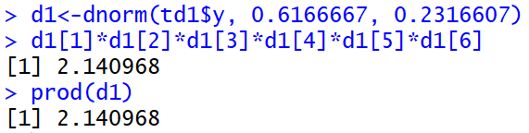
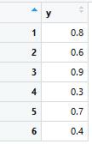
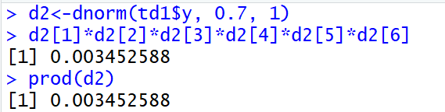
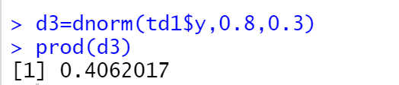
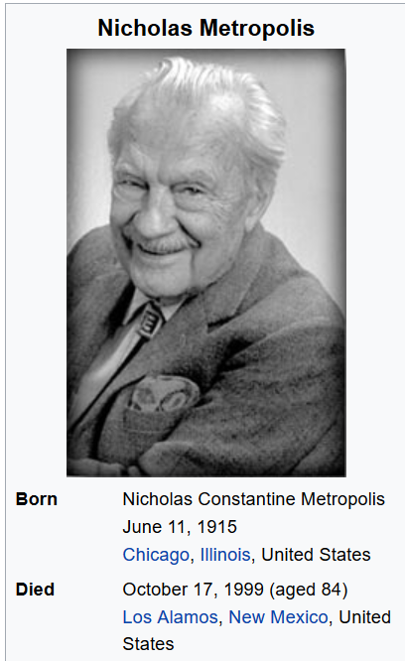
How to make the parameters change automatically，
and compare the matchness with observed data ?
Markov Chain Monte–Carlo (MCMC) sampling (Metropolis et al. ,1953)

Slide 24
MCMC—让人拍案叫绝的抽样原理
MCMC 抽样法是我目前接触到的统计中，
最为让人惊叹的理念和方法！！！

Slide 25
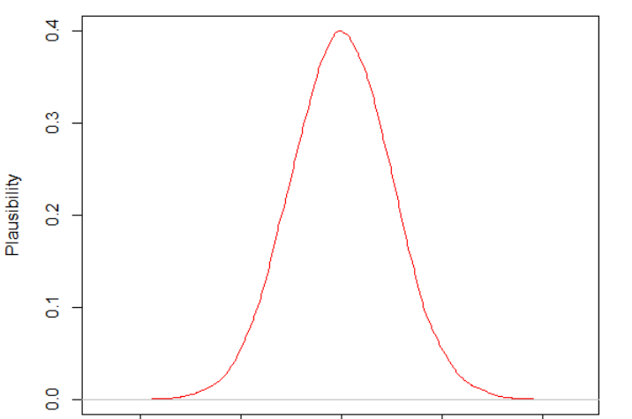
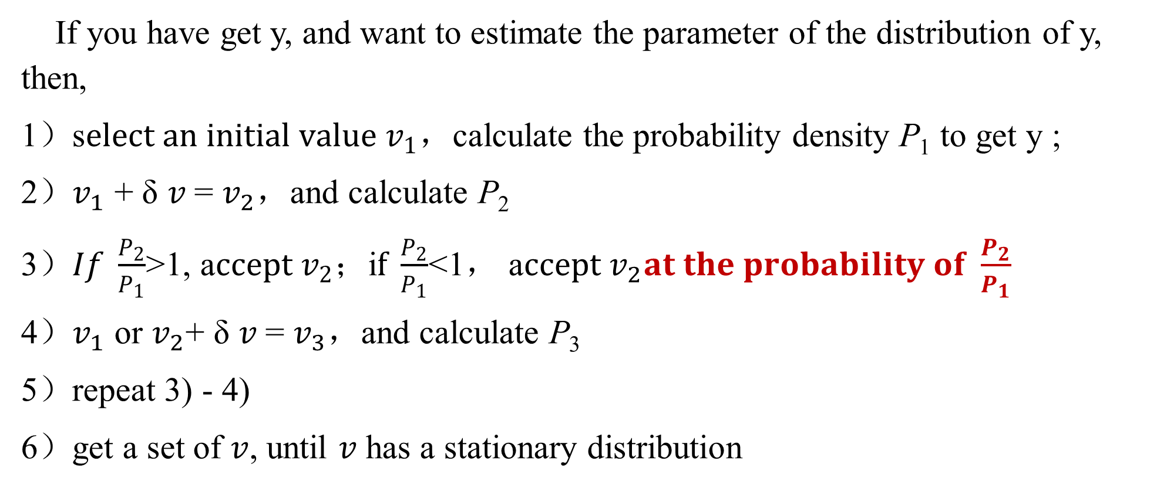
Markov Chain Monte–Carlo(MCMC)
If you have get y, and want to estimate the parameter of the distribution of y, then,
1）s$elect an initial value v_{1}$，calculate the probability density P₁ to get y ;
2）$v_{1}$ + δ $v$= $v_{2}$，and calculate P₂
3）$If \frac{P_{2}}{P_{1}}$>1, a$ccept v_{2}$；i$f \frac{P_{2}}{P_{1}}$<1， a$ccept v_{2}at the probability of \frac{P_{2}}{P_{1}}$
4）$v_{1}$ or $v_{2}$+ δ $v$= $v_{3}$，and calculate P₃
5）repeat 3) - 4)
6）get a set of $v$, until $v$ has a stationary distribution
Density
Value of the parameter

Slide 26
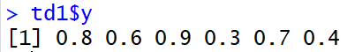
Example: MCMC sampling
Question：What is the hit rate of paper publication in a university？
data：6 researchers， hit rate: 0.8， 0.6， 0.9， 0.3, 0.7， 0.4

Slide 27
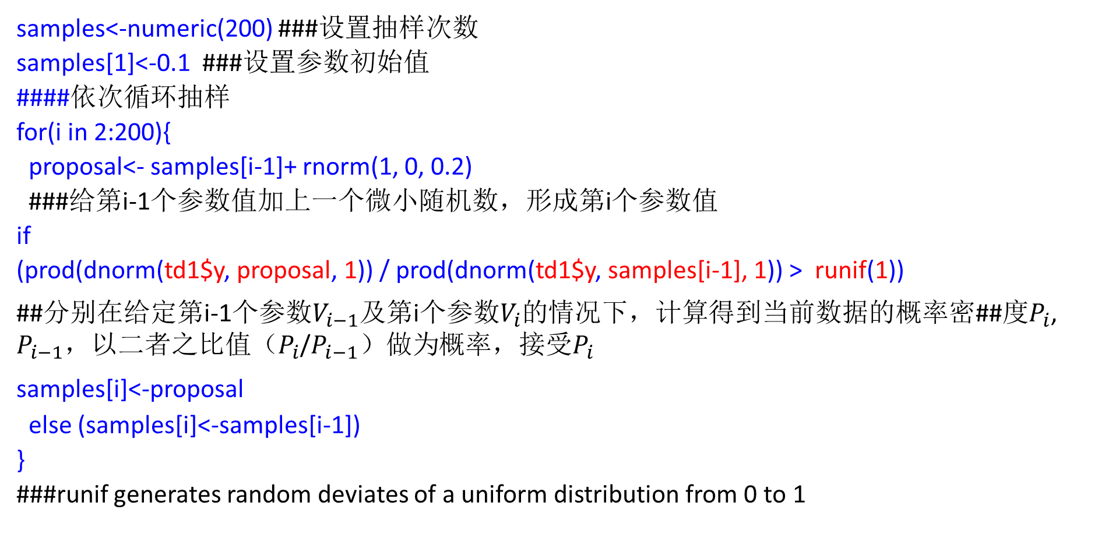
Markov Chain Monte–Carlo(MCMC)抽样案例
samples<-numeric(200) ###设置抽样次数
samples[1]<-0.1 ###设置参数初始值
####依次循环抽样
for(i in 2:200){
proposal<- samples[i-1]+ rnorm(1, 0, 0.2)
###给第i-1个参数值加上一个微小随机数，形成第i个参数值
if
(prod(dnorm(td1$y, proposal, 1)) / prod(dnorm(td1$y, samples[i-1], 1)) > runif(1))
##分别在给定第i-1个参数$V_{i−1}$及第i个参数$V_{i}$的情况下，计算得到当前数据的概率密##度$P_{i}$, $P_{i−1}$，$以二者之比{值（P}_{i}$/$P_{i−1}）做为$概率，接受$P_{i}$
samples[i]<-proposal
else (samples[i]<-samples[i-1])
}
###runif generates random deviates of a uniform distribution from 0 to 1

Slide 28
The core of MCMC sampling
if
(prod(dnorm(td1$y, proposal, 1)) / prod(dnorm(td1$y, samples[i-1], 1)) > runif(1))
samples[i]<-proposal
else (samples[i]<-samples[i-1])
i$f P_{i}$/$P_{i−1}$= 0.4, the probability of 0.4 > runif(1)) is 0.4

Slide 29
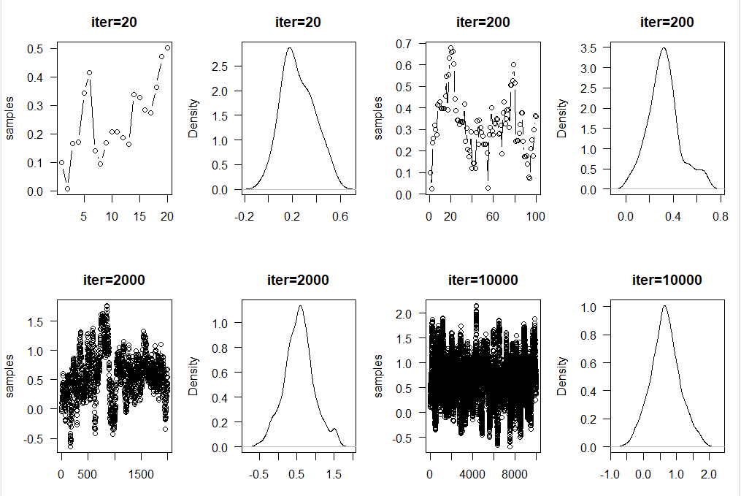
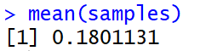
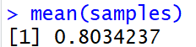
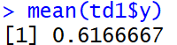
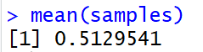
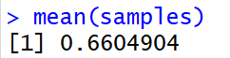
Example: Markov Chain Monte–Carlo(MCMC)
Change the iteration time

Slide 30
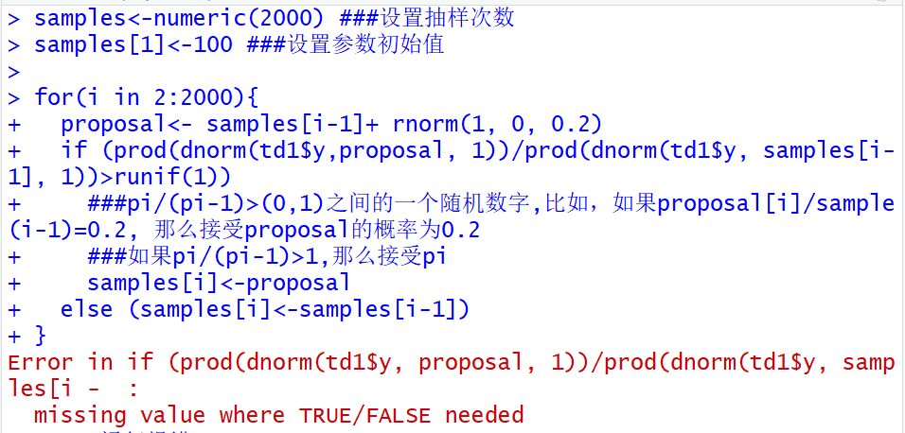
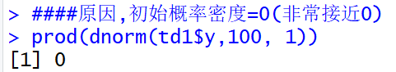
The set of initial value: You can guess，but don’t be unreasonable

Slide 31
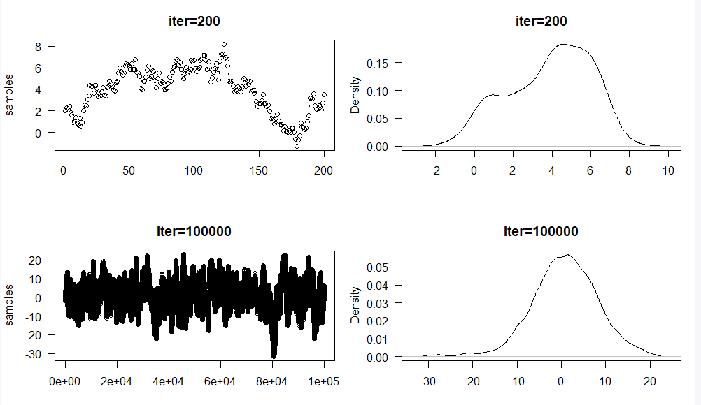
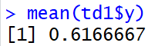
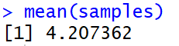
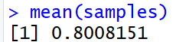
Iteration time

Slide 32
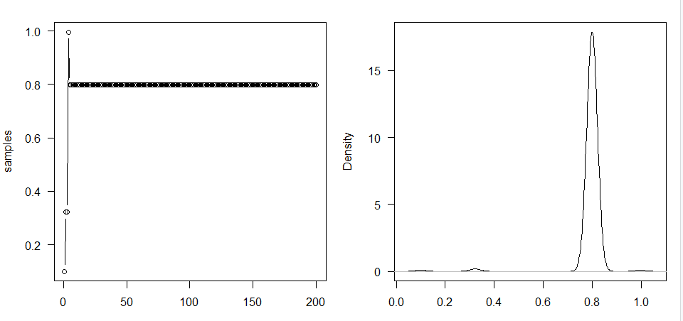
If we set when pi/p(i-1)>1, accept the new parameter，then
samples<-numeric(200)
samples[1]<-0.1
for(i in 2:200){
proposal<- samples[i-1]+ rnorm(1, 0, 0.1)
if ((dnorm(0.8,proposal, 1)/dnorm(0.8, samples[i-1], 1))>1)
samples[i]<-proposal
else (samples[i]<-samples[i-1])
}
The sample will be stable at a local maximum quickly, the model can’t go on.
The charm of MCMC is gone!

Slide 33
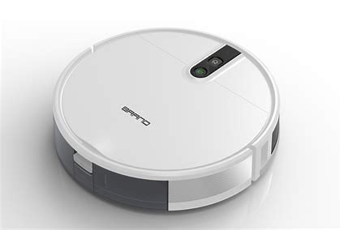
Example: floor cleaning robot
Design a floor cleaning robot according to MCMC
1）Set dirty index p, p is different at different position, and it can be detected by the robot.
2）The robot can change position（x, y）, and clean at that position.
3）The robot start from a position with p1, then go to next position with p2，if (p2>p1)，then stop at the new position, if (p2<p1), stop at the new position at the probability of p2/p1（has the possibility to go back）.
4）Repeat the above processes.
A cleaning genius!

Slide 34
Disadvantage of MCMC —— Slow
Gibbs sampling: update parameters one by one
Metropolis-Hastings sampling
Hamiltonian Monte Carlo
Update every parameters independently
Under the same iteration time， Hamiltonian Monte Carlo can get more samples

Slide 35


The application of MCMC
Intelligent drive
Intelligent pesticide spray
Aircraft which can automatically adjust speed according to weather
Terrorist recognition

Slide 36


MCMC related terminology: 先验分布 prior distribution
Y =${ b}_{0}$ +${ b}_{1}$x + error, error ~N(0,$σ^{2}$)
${ b}_{0}$, ${ b}_{1}$, $σ$ parameters
${ b}_{0}$, ${ b}_{1}：$uniform distribution，
normal distribution (mean=0, sd=1)，student’s t distribution（fuzzy information）
cauchy distribution
$σ$：>0, half-cauchy（stan），inverse-wishardt distribution (mcmcglmm)
r : correlation between b0 and b1, [0, 1], lkj distribution

Slide 37


回归系数的先验分布
正态分布与 student t分布
均匀分布
https://www.jmp.com/en_us/statistics-knowledge-portal/t-test/t-distribution.html

Slide 38

回归系数的先验分布--Cauchy分布
更多分布对比http://mc-stan.org/rstanarm/reference/priors.html

Slide 39

回归系数的先验分布：horseshoe分布
https://bookdown.org/marklhc/notes_bookdown/model-comparison-and-regularization.html

Slide 40


方差的先验分布: half-cauchy
https://distribution-explorer.github.io/continuous/halfcauchy.html

Slide 41



方差的先验分布: Inverse-wishardt分布
https://bookdown.org/mrwhalen/bayes_book/mcmcglmm.html

Slide 42

参数相关系数的先验分布：lkj分布
Lewandowski-Dorota Joe 分布
Lkj(2)
https://eager-roentgen-523c83.netlify.app/2014/12/27/d-lkj-priors/

Slide 43


MCMC related terminology: 链 Chains One sequence of sampled values. 具有一定抽样次序的值

Slide 44

MCMC related terminology: warm up ≈ burn in
去除初始值，初期不稳定的抽样值对后验分布的影响:
Early samples which are discarded, because the chain has not converged. Decisions about burn–in occur after the sampling routine is complete. Deciding on an appropriate burn–in is essential before performing any inference.

Slide 45


MCMC related terminology : 收敛convergence
Gelman-Rubin convergence statistic
$\hat{R}$=链间方差/链内方差<1.1
(或1.01)则认为参数估计已收敛
Rhat close to 1
Gelman, A. and D. B. Rubin (1992) Inference from iterative simulation using multiple sequences (with discussion). Statistical Science, 7:457-511.

Slide 46

Markov Chain Monte–Carlo(MCMC) Never convergent in theory
proposal<- samples[i-1]+ rnorm(1, 0, 0.1)
if ((dnorm(0.8,proposal, 1)/dnorm(0.8, samples[i-1], 1))>runif(1))
samples[i]<-proposal
### $\frac{P_{i}}{P_{i−1}}$ = (0,1)之间的值，
### 那么以与该值相等的概率接受$P_{i}$
### 如果proposal/sample(i-1)=0.4, ### 那么接受proposal的概率为0.4

Slide 47
MCMC related terminology : thin
thin=: every n iteration，keep one value，reduce correlation between the values

Slide 48
Software for Bayesian statistics
winBugs (Gibbs )
OpenBUGS (Gibbs )
JAGS (Gibbs, Just Another Gibbs Sampler)
INLA (数学近似法，速度快，但有自己独特写法)
stan（Hamiltonian Monte Carlo）
上述软件都已实现与R的关联，使用时需要先安装以上软件，之后从R中进行调用
不同软件语法结构不同，但都相当繁琐

Slide 49

Bayesian model
1) data（y~x1+x2+…）（format: list）
2) likelihood function, the probability to produce the observed data under give parameters，y~dnorm($b_{0}+b_{1}x1$+$b_{2}$x2, sigma)
3) Prior distribution：${如b}_{0}$, $b_{1}$, $b_{2}$~ norm(0, 10), sigma~cauchy(0, 3)
4) Other parameters (from the results of the model, not necessary)
5) Start！！！

Slide 50
Complex, complex, complex! e.g. linear regression
######## 一般线性模型bugs拟合
library(R2OpenBUGS)
RIKZ <- read.delim("RIKZ.txt")
###把数据转成list格式
data <- list(Y = RIKZ$Richness, x = RIKZ$NAP, N = 45)
###似然函数
bug_model <- function()
{ for (j in 1:N)
{ Y[j] ~ dnorm(mu[j], tau)
## 似然函数，注意bugs中，定义的为正态分布的均值与方差的倒数（精确度）
mu[j] <- beta0 + beta1 * x[j] ## 定义模型
}
####参数的先验分布
beta0 ~ dnorm(0, 0.001)
beta1 ~ dnorm(0, 0.001)
tau ~ dgamma(0.001, 0.001)
sigma <- 1/sqrt(tau) }
###参数初始值
lineinits <- function() { list(beta0 = 1, beta1 = 1, tau = 1) }

Slide 51

Complex, complex, complex! e.g. linear regression
####运行模型
bugm0 <- bugs(data, lineinits, c("beta0", "beta1", "sigma"), bug_model,
n.iter = 1000, n.burnin = 100, n.thin = 1, n.chains = 4,
summary.only = F, DIC =T)
print(bugm0) ##查看模型结果

Slide 52

一般线性模型拟合bugs
bugm1 <- bugs(data, lineinits, c("beta0", "beta1", "sigma"), bug_model, n.iter = 1000, n.burnin = 100, n.thin = 1, n.chains = 4, codaPkg = T, summary.only = F, DIC =T)
library(coda)
bugm1_1 <- read.bugs(bugm1)
summary(bugm1_1)
plot(bugm1_1)

Slide 53
一般线性模型的jags拟合
library(R2jags)
#### 数据转为list格式
data_jags <- list(Y = RIKZ$Richness, X = RIKZ$NAP, N = nrow (RIKZ))
lm_jags <- function(){
# 似然公式
for (i in 1:N){
Y[i] ~ dnorm(mu[i], tau) # tau is precision (1 / variance)
mu[i] <- beta0 + beta1 * X[i]
}
#先验分布设置
beta0 ~ dnorm(0, 0.01)
beta1 ~ dnorm(0, 0.01)
sigma ~ dunif(0, 100)
tau <- 1 / (sigma * sigma)
}
####初始值
init_values <- function(){
list(beta0 = rnorm(1), beta1 = rnorm(1), sigma = runif(1))
}

Slide 54


一般线性模型的jags拟合
###运行模型
jags_m1 <- jags(data = data_jags, inits = init_values, parameters.to.save = c("beta0", "beta1", "sigma"),
model.file = lm_jags,
n.chains = 3, n.iter = 12000, n.burnin = 2000, n.thin = 10, DIC = F)
###对模型拟合链作图
jags_m1_mcmc <- as.mcmc(jags_m1)
plot(jags_m1_mcmc)
###查看模型结果
jags_m1

Slide 55


一般线性模型的stan拟合
library(rstan)
stan_model<-"data {
int<lower=0> N; // 样本量，整数
vector[N] x; 向量x
vector[N] y; 向量y }
parameters {
real beta0;
real beta1;
real<lower=0> sigma;// sd, 不能小于0}
//似然函数
model {
y ~ normal(beta0 + beta1 * x, sigma); }“
stan_data<-list(y=RIKZ$Richness, x=RIKZ$NAP,
N= nrow(RIKZ))
stan_lm <- stan(model_code=stan_model, data =stan_data, iter = 2000, chains =4, cores=4)
summary(stan_lm,c("beta0","beta1","sigma"))

Slide 56



不同软件结果对比
openbugs
jags
stan
最小二乘法
对于简单模型来说，贝叶斯统计没有优势

Slide 57

“Brms” simple as lme4
An R Package for Bayesian Multilevel Models using Stan

Slide 58
How does brm work?
在R中安装brms包，并下载安装与操作系统匹配的Rtools软件，也可同时安装贝叶斯作图包Bayesplot
Brms transform the language of lme4 to stan

Slide 59
Know your data , select the model according to the distribution of y
Data type | 案例 | 理论分布 | 对应模型
连续变量 Continuous variables | 如身高、体重、血压、作物产量等，可以对数据进行log, logit等装换，以促进其正态性 | 正态分布 Normal distribution | 一般线性模型 Linear regression model
计数数据 Counting number | 物种个数，病人个数等，可能存在过度离散或零膨胀问题 Abundance, number of sickness (discretization, zero inflation) | Poisson（均值=方差） | 泊松回归 Poisson regression 伪泊松回归 负二项回归Negative binomial regression 零膨胀泊松回归Zero inflating passion regression 零膨胀负二项回归 Zero inflation negative binomial regression
0,1数据 | 成功/失败，男/女， 是否出现 Success/Fail, Male/Female | Binomial 二项分布 | 二项回归 Binomial regression
由计数数据转化而来的比率数据 Ratio from Counting number | 成功率，康复率（可能存在过度离散或零膨胀） Succession rate, recovery rate(discretization, zero inflation) | Binomial 二项分布 | 二项回归Binomial regression 伪二项回归（过度离散） Quasi binomial regression 零膨胀二项回归 Zero inflation binomial regression
非负数据，但0较多 Non negative , many 0 | 每个人逛街的花费 Shopping cost |  | Hurdle模型
连续数据型比率数据 Continuous ratio | 土壤含水率，空气湿度 Water content ratio, RH | Beta分布 | Beta回归（也可logit转换后线性回归）
Continuous [0，+∞） | 生物量Biomss | Gamma分布（均值越大，方差越大） | Gamma回归

Slide 60
Nest, multi-level, y non-independent
来自同一个单元的不同数据点之间彼此更为相似，彼此不独立。
来自同一地点(如样方)的数据 data from one plot
来自同一物种的数据 data from one species
同一班级，不同同学的数据 data from the students from one class
同一对象，不同时间测量的数据measure one object at different time
来自同一篇文献的数据the data from the same paper
受亲缘关系影响的数据from the species that may have phenogeny relationship
…..

Slide 61
Traditional model v.s. Mixed model
线性模型（linear regression model）
加和模型(additive model)
广义线性模型（generalized linear model ）
广义可加模型(generalized additive model)
嵌套数据
nest
时间相关
temporal cor
空间相关
spatial cor
异质性
heterogeneous
重复测量
repeat measurement
线性混合模型（linear mixed regression model）
线性加和混合模型(additive mixed model)
广义线性混合模型（generalized linear mixed model ）
广义可加混合模型(generalized additive mixed model)
修改自Zuur et.al., 2009. Mixed effect models and extensions in Ecology with R

Slide 62

Brms: Simple,simple,simple! Slow, slow, slow!
library(brms)
m1<-brm(y~x1+x2+x3+x4+x5+x6+x7+x8+x9+x10+x11+x12+x13+x14+x15+ y1+y2+y3+lyx1+lyx2+lyx3+lyx4+lyx5+lyx6+lyx7+lyx8+hx1+hx2+hx3+hx4+hx5+hx6+hx7+hx8+hx9+hx10+hx11+hx12+hx13+
(1|lake:year)+(1|year)+(1|lake)+(1|huc), chains=4,iter=2000,
prior = c(set_prior("horseshoe(1)", class="b")),
data=d1)

Slide 63
Linear mixed effect model

Slide 64

The application of brms—linear mixed effect model
m1<-brm(Reaction~Days + (Days|Subject), data = sleepstudy)
Main parameters：
prior =, set or default
chains=, default = 4， the initial value is different
iter=, iteration time，default= 2000，warmup=1000
Family = , distribution
control=list(adapt_delta= , max_treedepth= ) 如设置adapt_delta= 0.99, max_treedepth= 15
See: https://www.rdocumentation.org/packages/brms/versions/0.1.0/topics/brm
lme4 ?

Slide 65


Brms: Result
bm1<-brm(Reaction~Days + (Days|Subject), data = sleepstudy)
v
Basic information of the model
Rhat ($\hat{R}$)<1.1,
也可<1.01
表示参数
估计收敛
sd of random
effect
sd
of fixed effect
sd of residual

Slide 66
Brms: prior
prior(prior = normal(mean, sd), class =“ ”, coef=))
class: 参数的类型: Intercept(截距) , b（斜率），sd (随机效应造成的方差)，cor (斜率和截距的相关性)， ar(自相关)，sigma (残差的SD)….
prior(prior = normal(0, 1), class = b),
prior(prior = student_t(3, 0, 10), class = Intercept),
因为sigma, sd>0, 所以可以设置其先验分布为half-cauchy分布
如 (prior = 'cauchy (0,2)', class='sd')
随机斜率和随机截距的相关性，一般设为lkj(2)分布
set_prior(prior = 'lkj(2)', class='cor')
对于sigma, 也有
half‐t distributions with df = 3 and scale = 10 for standard deviation of residuals

Slide 67
brms先验分布的设置
m1<-brm(Reaction~Days + (Days|Subject), data = sleepstudy)
prior = c(set_prior(“cauchy(0,2.5)”, class = “Intercept”), ###截距
set_prior(“cauchy(0,2.5)”, class = “b”, coef=“Days”), ###斜率
set_prior(“cauchy(0,2.5)”, class = “sd”),##随机效应方差
set_prior(“lkj(2)”, class = “cor”)) ###随机截距，随机斜率的相关性
m1<-brm(Reaction~Days + (Days|Subject), prior=prior, data = sleepstudy)

Slide 68

Check the default prior distribution
###查看默认先验分布
get_prior(Reaction~Days + (Days|Subject), data = sleepstudy)

Slide 69
注意：贝叶斯统计的参数的CI 叫做credible intervals
一般以参数的95% CI 是否与0有交叉作为其是否显著的标准

Slide 70

Extract the posterior data
post_data<-posterior_samples(bm1)###获取每一个模型的后验分布
View(post_data)

Slide 71


后验分布的意义
post_data<-posterior_samples(bm1)
plot(density(post_data$b_Days))
polygon(density(post_data$b_Days),col="slategray1")
plot(hist(post_data$b_Days))
分布频率
概率密度

Slide 72


Visualize the results
plot(bm1)
给出的都是参数分布

Slide 73


brms的应用—变截距、变斜率LMM模型 获取后验分布数据
stanplot(bm1)
stanplot(bm1, type = "trace")

Slide 74


brms的应用—变截距、变斜率LMM模型 获取后验分布数据
pp_check(bm1, nsamples=1000)
stanplot(bm1, type = "hist" )
依据模型产生模拟数据
与原数据进行对比

Slide 75

The relationship between x and y
plot(marginal_effects(bm1, resolution = 100),
points=T)
resolution ，用来拟合回归线及其置信区间的点数量
points= , 是否保留原始数据， 即图中的黑点

Slide 76

Extract data plot with ggplot2
##可以提取模型拟合的数据直接用ggplot2作图
bd1<-plot(marginal_effects(bm1, resolution = 100), points=T)
###提取作图数据
bd2<-bd1$Days$data
library(ggplot2)
f1<-ggplot(sleepstudy, aes(x =Days, y=Reaction))+ theme_bw()+
geom_point(size=3,color="red")+
geom_ribbon(data=bd2,aes(ymin=lower__,
ymax=upper__), fill = "grey70",alpha=0.7)+
geom_line(data=bd2,aes(x =Days, y=bd2$estimate__),color='steelblue',size=2)
plot(f1)

Slide 77

brms的应用—结果作图 也可以调用tidybayes下的add_fitted_draws函数来预测作图
library(tidybayes)
library(tidyverse)
library(modelr)
f2<-sleepstudy %>%
data_grid(Days= seq_range(Days, n =nrow(sleepstudy))) %>%
add_fitted_draws(model =bm1,
re_formula =NA,
allow_new_levels = TRUE)%>%
ggplot(aes(x =Days, y = Reaction)) +geom_point(data =sleepstudy, col=“red")+
stat_lineribbon(aes(y = .value),.width = c(.95,0.5),alpha = 1/4,show.legend=F)+
scale_fill_brewer(palette = "Dark2")+
theme_bw()+
labs(x="Days")+
labs(y="Reaction")
plot(f2)

Slide 78



模型的解释度bayes_R2
bayes_R2的计算原理：$V_{predicted values}/(V_{predicted values}+V_{residuals})$
用预测值（predicted values）的方差除以预测值的方差+残差的方差,
相当于conditional R2：即固定效应+随机效应一起对y的解释度
也可以用performance 包直接求conditional 与 marginal R2

Slide 79
ICC的计算：当模型含有多个随机因素时 如何单独求某一随机因素的ICC
如果随机效应A的方差是v1, 随机效应B的方差是V2，那么二者一共造成的方差不是v1+v2
即单个随机效应的ICC之和并不等于模型的总ICC，因为计算ICC的分母不同。
如随机效应A的ICC=包括A的模型的predicted values的方差 减去 去掉随机效应A后的模型predicted values的方差，然后除以前者。
所以由于计算时用的分母不同，不同随机效应的ICC无绝对可比性。

Slide 80


贝叶斯混合模型对y预测的几种形式
首先明确混合模型方差来源的组成：
1) 固定效应造成的方差 v(fixed)
2) 随机效应造成的方差 v(random)
3) 残差 v(residual)
The method to predict y
只依据固定效应对y进行预测fitted()，不包括残差部分 no v(residual)
依据所有因素对y进行预测predict()，包括残差部分 include v(residual)
只依据固定效应和某些随机效应对y进行预测predict(, re_formula=), 包括残差
v$(fixed)$
V
v$(random)$
v(residual)
即fitted()的预测都不包括残差部分，而predict()都包括残差部分

Slide 81



v(fixed)
v(fixed)+v(residual)
v(fixed)+v(random)+v(residual)
pd1<-as.data.frame(fitted(bm1, re_formula =NA))###v(fixed)
plot(sleepstudy$Days, pd1$Estimate, xlab="Raw Y", ylab="predicted Y based on fixed effects")
pd2<-as.data.frame(predict(bm1, re_formula =NA))###v(fixed)+v(residual)
plot(sleepstudy$Days, pd2$Estimate, xlab="Raw Y", ylab="predicted Y based on fixed effect and error")
pd3<-as.data.frame(predict(bm1, re.form =~(Days|Subject))) ##v(fixed)+v(random)+v(residual)
plot(sleepstudy$Days, pd3$Estimate, xlab="Raw Y", ylab="predicted Y based on all effects")

Slide 82



Raw y v.s. predict y
v(fixed)
v(fixed)+v(residual)
v(fixed)+v(random)+v(residual)

Slide 83




brms的应用—多元回归
bm2 <- brm(popular ~ sex + extrav + sex:extrav + texp + (1|class), data = pdata, warmup = 1000, iter = 3000,
cores = 2, chains = 2, seed = 123)
plot (marginal_effects(bm2,resolution = 100), points=T)
受欢迎程度
性别
性格外向程度
老师教学经验
性别和性格外向程度的交互作用

Slide 84

Variable selection

Slide 85


模型对比（loo命令）
bm2 <- brm(popular ~ sex + extrav + sex:extrav+texp + (1|class),
data = pdata,
warmup = 1000, iter = 3000,
cores = 2, chains = 2,
seed = 123)
bm3 <- brm(popular ~ sex + extrav +texp + (1|class),
data = pdata,
warmup = 1000, iter = 3000,
cores = 2, chains = 2,
seed = 123)
bm4<- brm(popular ~ sex + extrav + (1|class),
data = pdata,
warmup = 1000, iter = 3000,
cores = 2, chains = 2,
seed = 123)
WAIC值越低越好

Slide 86

Model selection（WAIC, loo命令）
loo(bm2, bm3, bm4)
elpd值越大越好
最优模型在排在第一位
与其他模型对比
若差值的绝对值，
大于2*se，则模型差异较大
We compared all three models by their approximate leave-one-out cross-validated
expected log predictive density (LOO-ELPD), which is an information-theoretic
criterion of the model fit for Bayesian models similar to the AIC. The final model
(i.e., with or without smoothing function) was chosen based on the maximum
LOO-ELPD.
Senf, C., A. Buras, C. S. Zang, A. Rammig, and R. Seidl. 2020. Excess forest mortality is consistently linked to drought across Europe. Nature Communications 11:6200.

Slide 87


多重比较
bm5 <- brm(y~ x3 + (1|Site),
data = multi_data ,
warmup = 1000, iter = 3000,
cores = 2, chains = 2,
control = list(adapt_delta = 0.99),
seed = 123)
plot(marginal_effects(bm5,resolution = 100),points=T)
hypothesis(bm5,'x3b+Intercept=Intercept')
hypothesis(bm5,'x3b-x3c=0')

Slide 88


多重比较-hypothesis命令
bm5 <- brm(y~ x3 + (1|Site),
data = multi_data ,
warmup = 1000, iter = 3000,
cores = 2, chains = 2,
control = list(adapt_delta = 0.99), seed = 123)
plot(marginal_effects(bm5,resolution = 100),points=T)
hypothesis(bm5,'x3b+Intercept=Intercept')
hypothesis(bm5,'x3b-x3c=0')

Slide 89



多重比较-hypothesis命令
h_test<-hypothesis(bm5,
hypothesis = c('x3b+Intercept=Intercept',
'x3b-x3c=0',
'x3c-x3d=0'))
library(bayesplot)
mcmc_intervals(h_test$samples, pars=c("H1", "H2", "H3"))
mcmc_dens(h_test$samples,pars=c("H1", "H2", "H3"))
mcmc_areas(h_test$samples, pars=c("H1", "H2", "H3"), prob=.95)
多个假设一并执行

Slide 90

多重比较-hypothesis命令
##### 检验b/c是否=1 （注意，这是b, c水平下，参数估计值的符号必须相同）
h_test2<-hypothesis(bm5,hypothesis = c(
'x3b/x3c=1',
'x3c/x3d=1'))
h_test2
mcmc_areas(h_test2$samples, pars=c("H1", "H2"), prob=.95)

Slide 91

贝叶斯彻底解决了多重比较的第一类型统计错误问题和部分的解决了type s 错误问题
##传统统计
y <- theta + rnorm(N, 0, sigma)
theta <- rnorm(N, 0, tau)
signif_classical <- abs(y) > 2*sigma
##贝叶斯统计
theta_hat_bayes <- y * (1/sigma^2) / (1/sigma^2 + 1/tau^2)
theta_se_bayes <- sqrt(1 / (1/sigma^2 + 1/tau^2))
signif_bayes <- abs(theta_hat_bayes) > 2*theta_se_bayes
频率统计和贝叶斯统计犯第一类型统计错误和type S统计错误的概率对比的模拟Gelman自己写的 spidey函数
所以贝叶斯统计中进行多重比较时，无需像频率统计那样进行类似Bon P值矫正的操作
https://statmodeling.stat.columbia.edu/2016/08/22/bayesian-inference-completely-solves-the-multiple-comparisons-problem/

Slide 92
Linear mixed effect model: 随机截距+随机斜率，分类与数值变量的交互作用
brm(CN_ratio ~ 1 + day * treatment + (1 + day | pond),
data = dplyr::filter(data, sample == "phytoplankton"),
chains = 4,
cores = 4,
iter = 3e4,
warmup = 25e3)

Slide 93


可指定残差SD的变化，即处理方差异质性

Slide 94

解决divergent transitions 问题 control=list()命令
bm8 <- brm(brmsformula(scale(ALGAE)~TREAT + (1|PATCH), sigma ~ TREAT),
control = list(adapt_delta = 0.999,
max_treedepth = 12),
data=andrew, iter=5000, chains=4, cores=4)

Slide 95
关于先验分布—不同类型的先验分布对结果影响
##默认先验分布
prior_defa = c(set_prior("normal(0,1)", class = "lscale"),
set_prior("normal(0,1)", class = "sdgp"))
# Weak 先验分布
prior_weak = c(set_prior("normal(0,1)", class = "lscale"),
set_prior("normal(0,1)", class = "sdgp"),
set_prior("normal(0,1)", class = "b"),
set_prior("normal(0,1)", class = "b", coef = "z.footprint"),
set_prior("normal(0,1)", class = "b", coef = "z.obsM"))
# Informative 先验分布
prior_info = c(set_prior("normal(0,1)", class = "lscale"),
set_prior("normal(0,1)", class = "sdgp"),
set_prior("normal(0,1)", class = "b"),
set_prior("normal(-0.4,0.3)", class = "b", coef = "z.footprint"),
set_prior("normal(0.4,0.3)", class = "b", coef = "z.obsM"))
(Kuehl et al. 2019, Science 363:1453-1455.)

Slide 96



brms模型实际应用案例3—先验分布的设置

Slide 97
先验分布的设置
hier_prior <- c(set_prior(prior = 'normal(0,1)', class='b', coef='cYEAR'),
set_prior(prior = 'normal(0,2)', class='Intercept', coef=''),
set_prior(prior = 'cauchy(0,2)', class='sd'),
set_prior(prior = 'lkj(2)', class='cor'))
Jne_norm_BTSRfyID <- brm(bf(Jne_base ~ cYEAR + (cYEAR|Biome/taxa_mod/STUDY_ID/rarefyID),
family = brmsfamily('gaussian')),
data= rarefied_medians %>% filter(BROAD_TYPE=='count'),
prior=hier_prior,
inits = '0',
iter = 2000,
cores = 4,
chains = 4)
Correlations between levels of the grouping-factors (e.g., taxa with biomes) are estimated using the Cholesky decomposition (L) of the correlation matrix, with a Lewandowski-Dorota-Joe (LKJ) prior, here set as: 𝐿𝐿 ∼ 𝐿KJ(2).
随机效率和随机截距的相关系数的先验分布 设置为𝐿KJ(2)型

Slide 98


可指定残差SD的变化，即处理方差异质性
###brmsformula 可以同时定义多个方程
bm8 <- brm(brmsformula(scale(ALGAE)~TREAT + (1|PATCH), sigma ~ TREAT),
control = list(adapt_delta = 0.999,
max_treedepth = 12),
data=andrew, iter=5000, chains=4, cores=4)
summ <- summary(brm.mm)$fixed[c(1,3,4,5,2,6,7,8),
c("Estimate", "l-95% CI", "u-95% CI")]
###模型bm8也可以写为
bm9 <- brm(bf(scale(ALGAE)~TREAT + (1|PATCH), sigma ~ TREAT),
control = list(adapt_delta = 0.999, max_treedepth = 12),
data=andrew, iter=5000, chains=4, cores=4)

Slide 99

lmm, 时间自相关--ar()
dar1<-read.csv("ar1.csv")
library(brms)
bm10= brm(y ~ x, data = dar1,
autocor = cor_ar(form = ~year, p = 1), iter = 10000,
warmup = 2000, chains = 3, thin = 2,
prior = c(prior(normal(0, 100), class = "Intercept"),
prior(normal(0, 10), class = "b"),
prior(cauchy(0,5), class = "sigma")))
summary(bm10)
#### 注意，在brms 较新版本中，这一函数已经停用，可以用ar函数替代
### ar函数的网址 https://rdrr.io/cran/brms/man/ar.html

Slide 100
lmm 时间自相关-实际应用案例
m.li.p <- brm(data = d.at.p, family = gaussian,
log_conc ~ co * high_N * high_P,
autocor = cor_ar(~time),
prior = c(prior(normal(0.25, 0.73), class = b, coef = co),
prior(normal(0.08, 0.76), class = b, coef = high_N),
prior(normal(-0.19, 0.83), class = b, coef = high_P),
prior(normal(0, 1), class = b, coef = co:high_N),
prior(normal(0, 1), class = b, coef = co:high_P),
prior(normal(0.17, 1.06), class = b, coef = high_N:high_P),
prior(normal(0, 1), class = b, coef = co:high_N:high_P),
prior(normal(0, 10), class = Intercept)),
iter = 6000, warmup = 1000, chains = 3, cores = 2)
We used data from an experiment that measured PAV and RPV densities and transmission under similar conditions to inform some of the priors for the density and transmission models (Lacroix et al. 2017); general priors were used otherwise
A first-order autocorrelation structure was used to account for correlations between virus density values on consecutive harvesting days.
Kendig, A. E., Borer, E. T., Boak, E. N., Picard, T. C. & Seabloom, E. W. Host nutrition mediates interactions between plant viruses, altering transmission and predicted disease spread. Ecology 101, e03155, doi:https://doi.org/10.1002/ecy.3155 (2020).

Slide 101

空间自相关(glmm案例)
d <- read.csv("spd.csv")
bm11 <- brm(data = d, family = poisson,
total_tools ~ logpop+gp(lat, lon2) ,
prior = c(prior(normal(0, 10), class = Intercept),
prior(normal(0, 1), class = b),
prior(inv_gamma(2.874624, 0.393695), class = lscale),
prior(cauchy(0, 1), class = sdgp)),
iter = 1e4, warmup = 2000, chains = 4, cores = 4,
seed = 13,
control = list(adapt_delta = 0.999,
max_treedepth = 12))
marginal_effects(bm11)

Slide 102
模型里包括多个Y, 但X相同
data("BTdata", package = "MCMCglmm")
View(BTdata)
library(brms)
bm12 <- brm(mvbind(tarsus, back) ~ sex + hatchdate + (1|p|fosternest) + (1|q|dam), data = BTdata, chains = 2, cores = 2)
fit1 <- add_criterion(bm12, "loo")
注意，标红的p, q居然可以用任意字符替代

Slide 103

模型里包括多个Y, 但影响因素相同 分析多个Y对共同影响因素的响应的协同性
Within dams, tarsus length and back color seem to be negatively correlated,
while within fosternests the opposite is true. This indicates differential effects
of genetic and environmental factors on these two characteristics.

Slide 104


模型里包括多个Y, 但影响因素相同 分析多个Y对共同影响因素的响应的协同性
固定效应部分
残差
The small residual correlation rescor(tarsus, back) on the bottom of
the output indicates that there is little unmodeled dependency between tarsus length and back color.
两个Y的残差的相关性
注意：如果y不是正态分布，则无此residual相关性一项

Slide 105



不同的Y有不同的固定效应影响因素，但随机效应一样
###用sex解释y1, 用hatchdate解释y2, 随机效应一样
bf_tarsus <- bf(tarsus ~ sex + (1|p|fosternest) + (1|q|dam))
bf_back <- bf(back ~ hatchdate + (1|p|fosternest) + (1|q|dam))
bm13<- brm(bf_tarsus + bf_back, data = BTdata, chains = 2, cores = 2)

Slide 106
贝叶斯 Generalized linear mixed effect model

Slide 107
glmm中先验分布的指定
m_sevOrNot_extreme_1 <- brm(stand_replacing ~ het_ndvi_1_s * fm100_s + preFire_ndvi_s + topo_roughness_1_s + pahl_s + (1 | fire_id),
family = bernoulli(),
data = ss_burned_extreme,
sample_prior = TRUE,
iter = 3000, chains = 4, cores = 4,
prior = c(
prior(prior = normal(0, 1), class = b),
prior(prior = normal(0, 1), class = b, coef = fm100_s),
prior(prior = normal(0, 1), class = b, coef = het_ndvi_1_s),
prior(prior = normal(0, 1), class = b, coef = het_ndvi_1_s:fm100_s),
prior(prior = normal(0, 1), class = b, coef = pahl_s), 固定效应部分
prior(prior = normal(0, 1), class = b, coef = preFire_ndvi_s),
prior(prior = normal(0, 1), class = b, coef = topo_roughness_1_s),
prior(prior = student_t(3, 0, 10), class = Intercept),
prior(prior = student_t(3, 0, 10), class = sd),
prior(prior = normal(0, 1), class = sd, group = fire_id)))
截距项，class= Intercept
斜率项，class=b
随机效应部分
Koontz, M. J., North, M. P., Werner, C. M., Fick, S. E. & Latimer, A. M. Local forest structure variability increases resilience to wildfire in dry western U.S. coniferous forests. Ecol. Lett. 23, 483-494, doi:https://doi.org/10.1111/ele.13447 (2020).

Slide 108

贝叶斯-glmm with poissson error structure 计数数据
RIKZ <- read.delim("RIKZ.txt")
RIKZ$fBeach <- factor(RIKZ$Beach)
RIKZ$Sample <- factor(RIKZ$Sample)
bm14<-brm(Richness~NAP+(NAP|fBeach),
data =RIKZ, family = "poisson")
plot(marginal_effects(bm14),points=T)
其强大和便捷性，似乎只能用666来形容！！！

Slide 109

贝叶斯-glmm with poissson error structure 计数数据(如存在过度离散)
##### 如存在过度离散
##### add an observational level random effect
bm15<-brm(Richness~NAP+(NAP|fBeach)+(1|Sample),
data =RIKZ, family = poisson)

Slide 110



glmm with poissson error structure 计数数据-零膨胀
all.water.div <- read_csv("data/all_water.div.csv")
bm16 <- brm(richness ~
water +
tmax +
last_3_ppt +
water:tmax+
water:last_3_ppt+
(1|numeric_day/site),
data=all.water.div,
family=zero_inflated_poisson)
数据来源 Lundgren, E. J. et al. Equids engineer desert water availability. Science 372, 491-+, doi:10.1126/science.abd6775 (2021).

Slide 111


glmm with binomial error structure 比率数据—零膨胀
#######zero inflated GLMM with poisson error structure
bm17<- brm(as.numeric(total_event_duration) ~
water +
last_3_tmax +
last_3_ppt +
(water:last_3_tmax)+
(water:last_3_ppt)+
(1|numeric_day/site),
control = list(adapt_delta = 0.999,
max_treedepth = 12),
chains=4,
cores=4,
data=all.water.div,
family=zero_inflated_binomial)
数据来源 Lundgren, E. J. et al. Equids engineer desert water availability. Science 372, 491-+, doi:10.1126/science.abd6775 (2021).

Slide 112



glmm with gamma error structure gamma分布—零膨胀
bm18 <- brm(value_m2 ~ plot_type + season +
(1|Site_Code),
data =sub_d1,
family=hurdle_gamma)

Slide 113

glmm with binomial error structure+ 系统发育关系矩阵
bm19 <- brm(threatened | trials(vetted) ~
diversification_scaled +
age_scaled + range.size + hybrids +
animal + fleshy.fruit + climate.sum +
herbaceous + annual + asexual +
(1|family) + (1|family_name),
data=data_vetted, family=binomial(),
iter=10000, thin=4,
cov_ranef = list(family = phy_cov_vetted),
control=list(adapt_delta=0.98,max_treedepth=13),cores=4)
Schmidt, J. P., Davies, T. J. & Farrell, M. J. Opposing macroevolutionary and trait-mediated patterns of threat and naturalisation in flowering plants. Ecol. Lett. 24, 1237-1250, doi:10.1111/ele.13740 (2021).

Slide 114


glmm with binomial error structure+ 系统发育关系矩阵
bm19 <- brm(threatened | trials(vetted) ~
diversification_scaled +
age_scaled + range.size + hybrids +
animal + fleshy.fruit + climate.sum +
herbaceous + annual + asexual +
(1|family) + (1|family_name),
data=data_vetted, family=binomial(),
iter=10000, thin=4,
cov_ranef = list(family = phy_cov_vetted),
control=list(adapt_delta=0.98,max_treedepth=13),cores=4)
Schmidt, J. P., Davies, T. J. & Farrell, M. J. Opposing macroevolutionary and trait-mediated patterns of threat and naturalisation in flowering plants. Ecol. Lett. 24, 1237-1250, (2021).

Slide 115
glmm-zero inflated binomial model+空间位置
bm20 <- brm(dead_count | trials(pipo_and_dead_count) ~
site_cwd_zscore +
prop_host_count_s +
pipo_and_dead_mean_height_s +
overall_tpha_s +
overall_bapha_s +
site_cwd_zscore:prop_host_count_s +
site_cwd_zscore:pipo_and_dead_mean_height_s +
site_cwd_zscore:overall_tpha_s +
site_cwd_zscore:overall_bapha_s +
prop_host_count_s:overall_tpha_s +
pipo_and_dead_mean_height_s:prop_host_count_s +
pipo_and_dead_mean_height_s:overall_bapha_s +
site_cwd_zscore:prop_host_count_s:pipo_and_dead_mean_height_s +
gp(x, y, by = site, scale = FALSE),
data = adf,
family = zero_inflated_binomial(),
iter = 5000,
warmup = 2000,
chains = 4,
cores = 4,
control = list(adapt_delta = 0.80))
Koontz, M. J., Latimer, A. M., Mortenson, L. A., Fettig, C. J. & North, M. P. Cross-scale interaction of host tree size and climatic water deficit governs bark beetle-induced tree mortality. Nature Communications 12, 13, doi:10.1038/s41467-020-20455-y (2021).

Slide 116
使用gp()函数控制空间自相关的案例
res.BRM.B.all=brm(Evidence_yn ~ z.footprint + z.obsM + Pan_tr_subspecie
+ gp(long, lat) +(1+z.footprint + z.obsM|Site)
+(1+z.footprint + z.obsM + Pan_tr_subspecie|Behavior) ,
data=xdata, family=bernoulli, prior = prior_defa,
sample_prior = TRUE, warmup = 1000,iter = 2000,
chains = 4, control = list(adapt_delta = 0.99, max_treedepth = 16))
较复杂的随机效应结构
(Kuehl et al. 2019, Science 363:1453-1455.)
A GP is a stochastic process, which describes the relation between one or more predictors x = (x_1, ..., x_d) and a response f(x), where d is the number of predictors.
gp(long, lat) 与设值具有相同经纬度的点(site为随机效应一样)，
只考虑了不同点不一样，但并未真正考虑点之间的空间距离
https://rdrr.io/cran/brms/man/gp.html

Slide 117
glmm-lognormal model
Sstd_lognorm_fragSize <- brm(S_std_mean ~ c.lfs + (c.lfs | dataset_label),
# two observations have zero for the response, remove for lognormal distribution
data = frag %>% filter(S_std_mean>0),
family = lognormal(), # our standardised richness are not integer values
cores = 4, chains = 4,
iter = 4000, thin = 2)
Chase, J. M., Blowes, S. A., Knight, T. M., Gerstner, K. & May, F. Ecosystem decay exacerbates biodiversity loss with habitat loss. Nature 584, 238-243, doi:10.1038/s41586-020-2531-2 (2020).

Slide 118

glmm zero inflated beta
Jne_zi_fragSize <- brm(bf(rich ~ cl10ra +
(cl10ra | dataset_label),
zi ~ cl10ra +
(cl10ra | dataset_label),
family = zero_inflated_beta()),
data = frag_beta %>% filter(method=='Baselga family, Jaccard'),
prior = rp,
cores = 4, chains = 4,
iter = 4000,
thin = 2)
rp <- c(prior(normal(0,2), class = Intercept),
prior(logistic(0,1), class = Intercept, dpar = zi),
prior(normal(0,1), class = b),
prior(exponential(1), class = sd))
Chase, J. M., Blowes, S. A., Knight, T. M., Gerstner, K. & May, F. Ecosystem decay exacerbates biodiversity loss with habitat loss. Nature 584, 238-243, doi:10.1038/s41586-020-2531-2 (2020).

Slide 119

glmm zero-one inflated beta model
Jtu_z1i_fragSize <- brm(bf(repl ~ cl10ra +
(cl10ra | dataset_label),
zoi ~ cl10ra +
(cl10ra | dataset_label),
coi ~ cl10ra +
(cl10ra | dataset_label),
family = zero_one_inflated_beta()),
# fit to data with variation in frag_size_num
data = frag_beta %>% filter(method=='Baselga family, Jaccard'),
cores = 4, chains = 4,
iter = 4000, thin = 2)
Chase, J. M., Blowes, S. A., Knight, T. M., Gerstner, K. & May, F. Ecosystem decay exacerbates biodiversity loss with habitat loss. Nature 584, 238-243, doi:10.1038/s41586-020-2531-2 (2020).

Slide 120
glmm-hurdle gamma model （即zero-inflated gamma model）
mod.ir.hgamm.soil <- brm(formula = biomass ~ pH + CN + totalP + BrayP + ECEC + BS + (1|block),
data = soil_w_ir_hgamm, family = hurdle_gamma(link = "log", link_shape = "log", link_hu = "logit"),
warmup = 1000, iter = 10000, chains = 4, thin = 10,
control = list(adapt_delta = 0.95))
mod.ir.hgamm.soil.1 <- update(mod.ir.hgamm.soil, iter = 50000)
summary(mod.ir.hgamm.soil.1, prob = 0.90, mc_se = TRUE, priors = TRUE)
## Plot the marginal effects
fit.hgamm.soil.gg <- plot(marginal_effects(mod.ir.hgamm.soil.1),points=T, prob = 0.90, plot = FALSE)
Carteron, A. et al. Soil abiotic and biotic properties constrain the establishment of a dominant temperate tree into boreal forests. J. Ecol. 108, 931-944, doi:https://doi.org/10.1111/1365-2745.13326 (2020).

Slide 121

非线性模型：广义可加模型
data(mcycle, package = 'MASS')
ggplot(mcycle, aes(x = times, y = accel)) + geom_point() + labs(x = "Miliseconds post impact", y = "Acceleration (g)", title = "Simulated Motorcycle Accident", subtitle = "Measurements of head acceleration")

Slide 122

非线性模型：广义可加模型
bm21 <- brm(bf(accel ~ s(times)), data = mcycle, cores = 4, seed = 17,
family=gaussian, iter = 4000, warmup = 1000,
control = list(adapt_delta = 0.99))
plot(marginal_effects(bm21,resolution = 100),points=T)

Slide 123



广义可加混合模型 generalized additive mixed effect model
###bf功能，可同时设置y的残差随自变量的变化，即可处理方差异质问题
bm22 <- brm(bf(y ~ s(x1) + s(x2) + (1|fac), sigma ~ s(x0) + (1|fac)), data = dat_smooth,
family = gaussian(), chains = 2, control = list(adapt_delta = 0.95))
plot(marginal_effects(bm22,resolution = 500),points=T)

Slide 124
glmm+线性+非线性+系统发育
model <- brm(ordinal_scale ~ mutation + sex + s(age1, k = 30) + s(dayssincefirstrecord, k = 30)
+ (1|cluster) + (1|gr(cog_tree_identifier, cov = A)),
family = cumulative(link = logit),
data = data, data2 = list(A = A), iter = 4000, warmup = 1500,
control = list(adapt_delta = 0.99999),
chains = 4, prior = bprior, refresh = 5)
Thomson, E. C. et al. Circulating SARS-CoV-2 spike N439K variants maintain fitness while evading antibody-mediated immunity. Cell 184, 1171-1187.e1120, doi:https://doi.org/10.1016/j.cell.2021.01.037 (2021).

Slide 125

brms---Y还可以是分类变量 Bayesian multinomial regression
Because of their complexity, we fit the models using variational Bayes with the mean field approximation.
mod = brm(type ~ any + (1 | name) + (1 | Species.name),
algorithm = "meanfield", save_ranef = FALSE, save_dso = FALSE, elbo_samples = 2500, tol_rel_obj=0.001, adapt_iter=500, grad_samples=5, seed=1,
prior = prior(normal(0,5), class = Intercept) +
prior(normal(0,5), class = b) +
prior(normal(0,1), class = sd, dpar="muGeneralist") +
prior(normal(0,1), class = sd, dpar="muMatrix"),
data = df,
family = categorical())
原理：把y的某一个水平作为基准，解释变量x变的时候，y变向其他水平的概率。

Slide 126
贝叶斯meta分析 首先计算yi, vi
library(metafor)
library(brms)
library(readr)
d1 <- read_csv("meta_sampledata.csv")
d2<-escalc(data=d1,measure="ROM", m1i=treatment_mean, sd1i=treatment_sd, n1i=treatment_n, m2i=control_mean,sd2i=control_sd, n2i=control_n)
####一定要把vi转化为se
d2$se<-sqrt(d2$vi)

Slide 127


贝叶斯meta分析—模型拟合
bayesian2<-brm(yi|se(se)~log(distance)+(1|reference)+(1|species),chains=4,data=subset(d2, group=="Birds"))
plot(marginal_effects(bayesian2),points=T)

Slide 128
模型中x也可以包含测量误差
brms_mod_final <- brm(density_log10 ~ 1 + me(abundance_log10, abundance_SD_log10) +
(1 + me(abundance_log10, abundance_SD_log10) |species),
data = mod_dat, save_mevars = T, chains = 2, iter = 3000, warmup = 1000)
Callaghan, C. T., Nakagawa, S. & Cornwell, W. K. Global abundance estimates for 9,700 bird species. Proc. Natl. Acad. Sci. USA 118, e2023170118, doi:10.1073/pnas.2023170118 (2021).

Slide 129

brms实际应用4—同时控制空间与系统发育自相关模型
We collected data from both published and previously unpublished sources that included
38,191 nests in 237 populations of 111
shorebirds species from 149 locations,
Encompassing all continents across a
70-year time span.

Slide 130
brms实际应用3—同时控制空间与系统发育自相关模型

Slide 131
brms实际应用3—同时控制空间与系统发育自相关模型
We used phylogenetically and spatially controlled generalized linear models.
Specifically, we control for
phylogeny…
spatial autocorrelation,…
number of nests
其核心：Linear mixed-effects kinship models with control for phylogeny (species level of phylogeny + random effect of the species), spatial autocorrelation and number of nests per population.

Slide 132
Linear mixed-effects kinship models with control for phylogeny (species level of phylogeny + random effect of the species), spatial autocorrelation and number of nests per population
固定效应
随机效应
library(coxme)
m4 <- lmekin( log(DPR) ~mean_year + log( N_nests)+ (1|species ),
varlist = list( I, phyloMat , distanceMatrix ),
data = data)
指定随机效应不同水平间的相关关系

Slide 133


矩阵I: number of nests per population
各个物种的鸟巢的相对多度

Slide 134


矩阵phyloMat: 物种间的系统发育距离
物种之间的系统发育距离

Slide 135


矩阵distanceMatrix3: 物种间的空间距离矩阵
物种之间的空间距离

Slide 136
如何用贝叶斯法实现上述分析

Slide 137
Brms实现方法-cov_ranef函数
library(brms)
m8<- brm(log(DPR) ~mean_year + log( N_nests)+
(1|species)+(1|location_id),
data =data,
family = gaussian(),
cov_ranef = list(species=phyloMat, location_id=distanceMatrix3),
chains=4,iter=2000)
summary(m8)
plot(m8)
pp_check(m8, iter=1000)
基于前期模型对比和运算速度考虑，这里只加入
物种之间的系统发育距离和地点之间空间距离两个矩阵

Slide 138

同时控制亲缘关系和空间自相关

Slide 139



Brms实现方法

Slide 140
双系统发育矩阵的加入(meta分析案例)
bm26 <- brm(data = dat,
eff_size | se(se, sigma = TRUE) ~ 1 + # allow both sampling error and residuals
method + trait_scale + door_scale + lifespan_allelo_scale + lifeform_allelo_scale + crop_allelo_scale + lifespan_test_scale + lifeform_test_scale + crop_test_scale +
duration_scale + I(duration_scale^2) + # design part 2
pd_scale + allelo_origin_3level * test_origin_3level +
(1 | Ref_ID) + (1|allelo_spp) + (1|test_spp) + (1|allelo_spp_nophylo) + (1|test_spp_nophylo) ,
cov_ranef = list(allelo_spp = allelo_tree, test_spp = test_tree),
control = list(adapt_delta = 0.9999, max_treedepth = 15),
iter = 3000, cores = 4)
Zhang, Z. J., Liu, Y. J., Yuan, L., Weber, E. & van Kleunen, M. Effect of allelopathy on plant performance: a meta-analysis. Ecol. Lett. 24, 348-362, doi:10.1111/ele.13627 (2021).

Slide 141
贝叶斯方差方差分解
叶片被吃掉多少与研究地点，物种，属，科等分类指标的关系,各 自贡献了多少方差？
做法，用brms产生stan 代码，通过修改stan代码，进行方差分解
基于finite population SD 的方差分解（gelman 2007）
方差分解，分解的并不一定是方差！
这种方差分解的案例见：
Ratcliffe, S. et al. Biodiversity and ecosystem functioning relations in European forests depend on environmental context. Ecol. Lett. 20, 1414-1426, doi:10.1111/ele.12849 (2017).

Slide 142
Brms方差分解
1、先写出模型的公式：
log(Herbivory/100+0.1)~(1|Family/Genus/Species)+(1|Site),data=z1)
2、通过make_stancode命令得到stan拟合的贝叶斯代码
make_stancode(log(Herbivory/100+0.1)~(1|Family/Genus/Species)+
(1|Site),data=z1)

Slide 143

3、对stan代码进行修改
将模型对y的估计值mu变成transformed parameters，则原始值Y-mu即为模型残差

Slide 144

4、在代码结尾，加上新的自定义变量
r_1_1, 对family 不同水平的估计值
r_2_1, 对genus不同水平的估计值
r_3_1, 对species 不同水平的估计值
r_4_1, 对site不同水平的估计值

Slide 145
5、把模型数据转变为stan能识别的数据格式
dfm1<-make_standata(log(Herbivory/100+0.1)~(1|Family/Genus/Species)+(1|Site),data=z1)
6、调用stan, 用修改后的模型和stan能识别的数据进行拟合
library(rstan)
brms_stan1 <- stan(model_code=model,
data =dfm1, iter = 1000, chains = 4,cores=4,
control = list(adapt_delta = 0.99))

Slide 146
7、把结果转化成数据框格式，加入变量名
sd_per_1<-as.data.frame(summary(brms_stan1,c("p1","p2","p3",
"p4","p_error")))
variable<-c("Family", "Genus",
"Species","Site", "Residual")
sd_per_1<-cbind.data.frame(variable, sd_per_1$summary.mean,
sd_per_1$summary.2.5.,
sd_per_1$summary.25.,
sd_per_1$summary.75.,
sd_per_1$summary.97.5.)
sd_per_1$variable <- factor(sd_per_1$variable,
levels =c("Residual","Species",
"Genus",
"Family","Site"))

Slide 147

对结果进行作图
vp3<-ggplot(sd_per_1, aes(x=sd_per_1$`sd_per_1$summary.mean`, y=variable)) +
geom_point(stat="identity", size=2.5,color="black")+
geom_errorbarh(aes(y=variable, xmin=sd_per_1$`sd_per_1$summary.2.5.`, xmax=sd_per_1$`sd_per_1$summary.97.5.`),height=0,size=0.7)+
geom_errorbarh(aes(y=variable, xmin=sd_per_1$`sd_per_1$summary.25.`, xmax=sd_per_1$`sd_per_1$summary.75.`),height=0,size=1.7)+
labs(x="Explained SD (%)",y="")+
theme_bw()+
theme(axis.text=element_text(size=16),
axis.title=element_text(size=16,face="bold"))
plot(vp3)

Slide 148

brms-方差分解案例 基于super population sd 的方差分解
(附件中有详细运算代码，但代码中有错误，应把代码中的
sigma替换为 sigma^2)
Barbour, M. A., S. Erlandson, K. Peay, B. Locke, E. S. Jules, and G. M. Crutsinger. 2019. Trait plasticity is more important than genetic variation in determining species richness of associated communities. Journal of Ecology 107:350-360.

Slide 149
很多看起来高深模型的模型，都是纸老虎
brm(stand_replacing ~ het_ndvi_1_s +focal_mean_ndvi_1_s +preFire_ndvi_s +
fm100_s +pahl_s + topo_roughness_1_s + focal_mean_ndvi_1_s:preFire_ndvi_s +
het_ndvi_1_s:focal_mean_ndvi_1_s + het_ndvi_1_s:preFire_ndvi_s +
het_ndvi_1_s:fm100_s +
(1 | fire_id),
family = bernoulli(),
data = ss_burned,
sample_prior = TRUE,
iter = 5000, chains = 4, cores = 4,
prior = c(prior(prior = normal(0, 1), class = b),
prior(prior = normal(0, 1), class = b, coef = het_ndvi_1_s),
prior(prior = normal(0, 1), class = b, coef = focal_mean_ndvi_1_s),
prior(prior = normal(0, 1), class = b, coef = preFire_ndvi_s),
prior(prior = normal(0, 1), class = b, coef = fm100_s),
prior(prior = normal(0, 1), class = b, coef = pahl_s),
prior(prior = normal(0, 1), class = b, coef = topo_roughness_1_s),
prior(prior = normal(0, 1), class = b, coef = focal_mean_ndvi_1_s:preFire_ndvi_s),
prior(prior = normal(0, 1), class = b, coef = het_ndvi_1_s:focal_mean_ndvi_1_s),
prior(prior = normal(0, 1), class = b, coef = het_ndvi_1_s:preFire_ndvi_s),
prior(prior = normal(0, 1), class = b, coef = het_ndvi_1_s:fm100_s),
prior(prior = student_t(3, 0, 10), class = Intercept),
prior(prior = student_t(3, 0, 10), class = sd),
prior(prior = normal(0, 1), class = sd, group = fire_id) ))
Koontz, M. J., North, M. P., Werner, C. M., Fick, S. E. & Latimer, A. M. Local forest structure variability increases resilience to wildfire in dry western US coniferous forests. Ecol. Lett. 23, 483-494, doi:10.1111/ele.13447 (2020).

Slide 150
很多看起来高深模型的模型，都是纸老虎
(1|species) + (1|species_name),
cov_ranef = list(species = phy_cov),
Pierick, K., Leuschner, C. & Homeier, J. Topography as a factor driving small-scale variation in tree fine root traits and root functional diversity in a species-rich tropical montane forest. New Phytol. 230, 129-138, doi:https://doi.org/10.1111/nph.17136 (2021).

Slide 151
很多看起来高深模型的模型，都是纸老虎
Soranno, P. A. et al. Spatial and temporal variation of ecosystem properties at macroscales. Ecol. Lett. 22, 1587-1598 (2019).

Slide 152
对参数设置horseshoe先验分布的意义

Slide 153
部分jags代码
for (i in 1:n){
y[i] ~ dnorm(mu[i], tau)
mu[i] <- beta0 + u1[lake[i]] + u2[year[i]] + u3[lake[i],year[i]] + u4[huc[i]]
}
# Random lake effect
for(j in 1:J){
u1[j] ~ dnorm(lake.hat[j],tau.lake)
lake.hat[j] <- a[1] * x1[j] + a[2] * x2[j] + a[3] * x3[j]+a[4] * x4[j]+a[5] * x5[j]+a[6] * x6[j]+a[7] * x7[j]+a[8] * x8[j]+
a[9] * x9[j]+a[10] * x10[j]+a[11] * x11[j]+a[12] * x12[j]+a[13] * x13[j]+a[14] * x14[j]+a[15] * x15[j]
}

Slide 154
部分stan代码
model_full<-"data {
int <lower=1> N; // 因变量y的总样本量
int <lower=1> J; // 随机效应lake的个数（水平数）
int <lower=1, upper=J> jj[N]; // 每个lake的唯一化编码
int <lower=1> K; // 随机效应huc的水平数
int <lower=1, upper=K> kk[N]; // huc 每个水平的唯一化编码
int <lower=1> L; // 随机效应year的水平数
int <lower=1, upper=L> ll[N]; // year每个水平的唯一化编码
int <lower=1> I; // year和lake的组合构成俄随机效应的水平数year*lake
int <lower=1, upper=I> ii[N]; // lake*year 每个组合水平的唯一化编码
vector [N] d; // 因变量y
matrix[J,15] X_lake; // lake水平上的解释变量X
matrix[K,13] X_huc; // huc水平上的解释变量X
matrix[L,3] X_year; // year水平上的解释变量X
matrix[I,8] X_ly; // lake*year水平上的解释变量X
}
parameters {
vector[J] a1; // lake造成的随机效应
vector[K] a2; // huc造成的随机效应
vector[L] a3; // year造成的随机效应
vector[I] a4; // lake*year造成的随机效应

Slide 155
全部brms代码
m1<-brm(y~x1+x2+x3+x4+x5+x6+x7+x8+x9+x10+x11+x12+x13+x14+x15+ y1+y2+y3+lyx1+lyx2+lyx3+lyx4+lyx5+lyx6+lyx7+lyx8+hx1+hx2+hx3+hx4+hx5+hx6+hx7+hx8+hx9+hx10+hx11+hx12+hx13+
(1|lake:year)+(1|year)+(1|lake)+(1|huc), chains=4,iter=2000,
prior = c(set_prior("horseshoe(1)", class="b")),
data=d1)

Slide 156
不同工具结果对比

Slide 157


自定义模型的拟合— 让你自由摇摆
library(nlme)
library(brms)
library(ggplot2)
plot(Orange$circumference~Orange$age)
y = $\frac{b_{1}}{1+e^{− \frac{x−b_{2}}{b_{3}}}}$ + error
Error~norm(0,sigma)

Slide 158

自定义模型的拟合
###写好自定义公式
f1 <- circumference ~ b1 / (1 + exp(-(age - b2)/b3))
####设置先验分布
prior_1 <- c(set_prior("normal(200, 50)", nlpar = "b1"),
set_prior("normal(700, 50)", nlpar = "b2"),
set_prior("normal(350, 50)", nlpar = "b3"))
###模型拟合
diy_bm1 <- brm(bf(f1,
b1 + b2 + b3 ~ 1,
nl = TRUE),
data = Orange, prior = prior_1, chains = 3)
###查看结果
plot(conditional_effects(diy_bm1), points=T)

Slide 159

自定义模型的拟合
####也可以直接写入公式
diy_bm2 <- brm(bf(circumference ~ b1 / (1 + exp(-(age - b2)/b3)),
b1 + b2 + b3 ~ 1,
nl = TRUE),
data = Orange,
prior = prior_1,
chains = 3)
plot(conditional_effects(diy_bm2), points=T)

Slide 160

自定义模型-同样可以加入随机效应
diy_bm3 <- brm(bf(f1,
b1 + b2 ~ 1,
b3 ~ (1|Tree), ###不同的Tree下，b3不同
nl = TRUE),
prior = prior_1,
data = Orange,
chains = 3)
summary(diy_bm3)
plot(conditional_effects(diy_bm3), points=T)

Slide 161

自定义模型的拟合
library(brms)
library(nlme)
#### 案例数据准备
Orange$y<-Orange$circumference
Orange$x<-Orange$age
Orange$t<-Orange$Tree
Orange$p<-c(1:35)
####必须设定先验分布
prior_1 <- c(set_prior("normal(0, 50)", nlpar = "u"),
set_prior("normal(0, 50)", nlpar = "k"))
####模型拟合
diy_bm4 <- brm(bf(y ~ u*(x/(k+x)),
u ~t+p,
k ~t+p,
nl = TRUE),
data = Orange,
prior = prior_1,
chains = 3)
案例来源 版纳植物园贺如川大师提问

Slide 162
总结—技术问题已不是贝叶斯统计的难题！
brms包功能异常强大，大大降低了贝叶斯统计的入门门槛。
“Fitting all kinds of regression models within one framework”--绝非妄言。
靠贝叶斯装高深的年代一去不复返了！
此包唯一的缺陷在于运算速度较慢。
应用固然重要，但不可忽视贝叶斯统计的理论背景。
实际应用中，希望大家多交流。

Slide 163


读物推荐
https://biol609.github.io/lectures/23c_brms_prediction.html

Slide 164
科研的核心在于科学问题，而不在于统计方法！
谢谢大家！！！

